Slide 1

Introduction To The Bible
G. Magee 2024

Slide 2
B.I.B.L.E – Basic Instructions Before Leaving Earth
Bibliotheca – Library
• 66 Books, 39 Old Testament & 27 New Testament, ~40 different Authors, written over the span of about 1600 years, one consistent unfolding story
• Widely and historically considered among Jews and Christians to be the Word of God, divinely inspired through God’s chosen authors, the Jewish Bible consists of our Old Testament Books only as most Jewish people do not accept that Jesus was the Messiah Whom the Old Testament refers to.

Slide 3
Old Testament ~1490 - 443 BC
Mostly Hebrew, some Aramaic, translated into Greek (Septuagint text) in the 3rd Century BC
Provides the origin and consistently connected unfolding Story of God’s interaction with His chosen people [chosen for what?, to bring the oracles of God and His salvation to the world]
  God’s promise to Abraham: Genesis 22:18 In your seed all the nations of the earth shall be blessed, because you have obeyed My voice.
  The Bible of Jesus’ day: Luke 24:27 And beginning at Moses and all the Prophets, He expounded to them in all the Scriptures the things concerning Himself.
Originally written without vowels, held sacred and diligently learned by Hebrew people
  Deuteronomy 11:19 You shall teach them to your children, speaking of them when you sit in your house, when you walk by the way, when you lie down, and when you rise up.
  Deuteronomy 4:2 You shall not add to the word which I command you, nor take from it, that you may keep the commandments of the LORD your God which I command you.

Slide 4
Old Testament ~1490 - 443 BC
Hebrew/Aramaic text carefully overseen by Masoretic, Jewish Scholars of 6th to 10th centuries AD, who added Hebrew vowels
  Worldwide Old Testament translations derived from the Masoretic Text with comparison to the Greek Septuagint
There was no question as to the pronunciation and therefore vowels except for the name of God which remains YHWH, considered too Holy for the Jews to pronounce they always substitute Adonay (LORD) or Hashem (The Name) most common guess by scholars at the vowels yields Yahweh (I AM) as God’s proper name.
  Exodus 3:13-14 Then Moses said to God, “Indeed, when I come to the children of Israel and say to them, ‘The God of your fathers has sent me to you,’ and they say to me, ‘What is His name?’ what shall I say to them?” And God said to Moses, “I AM WHO I AM.” And He said, “Thus you shall say to the children of Israel, ‘I AM has sent me to you.’ ”
Minor additions of Apocryphal Books found in various Christian denominations primarily Catholic and Orthodox (Apocryphal – of doubtful origin or inclusion but widely circulated)

Slide 5
New Testament ~40 – 96 AD
Mostly Koine Greek, some Aramaic statements
The original books and letters of the New Testament were written on papyrus and parchment which would have degraded perhaps even lost or destroyed during the ten major persecutions under Roman rule before the rule of Constantine the Great. Evidence shows that these were carefully copied over the centuries with scribes generally choosing those of greater quality and those of poorer quality being left far less copied.
To date over 5000+ Greek Bible Manuscripts have been found, extant prior to the days of the printing press (1440 AD), circa 3rd century to 15th century AD. In addition, 15000+ manuscripts of translations into other languages which may not compare Greek but do provide comparison of verses and verse content. These are comprised of full New Testaments, partial New Testaments, Copies of the various books, quotations or passages from the various books, scripture contained in the writings of Early Church Fathers.

Slide 6
New Testament ~40 – 96 AD
Of these 5000+ Greek Manuscripts
The oldest are often Alexandrian, the presumption being that the City of Alexandria in Egypt with its dry climate allowed for longer preservation of manuscripts, however these are few most probably as upper Africa was overtaken by Islam starting in the 7th century which led to the destruction of Christian Manuscripts.
Most of these 5000+ are considered Byzantine which makes sense as the Eastern Roman Empire held out far longer against encroaching Islam, Constantinople falling in 1453 AD, however the case for why these were copied more than manuscripts of Alexandrian origin is open to various speculations.
A Western Text Type (think European) is also categorized among some of these manuscripts being identified by the addition of paraphrased verses.

Slide 7
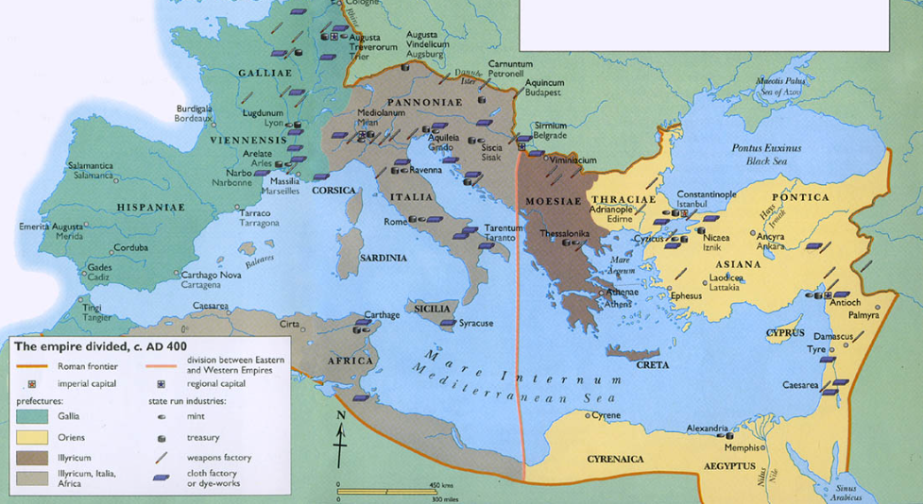

Slide 8
New Testament ~40 – 96 AD
Differences are found among these 5000+ manuscripts, yet the character of these copies having been preserved as special, sacred, holy, the word of God remains.
75% of all textual variants are neither meaningful nor viable or viable but not meaningful when it comes to the meaning of the collected texts. Mainly things like scribal word spelling differences or reversals like Jesus Christ instead of Christ Jesus.
24% of all textual variants are meaningful but not viable, for example in 1 Thessalonians 2:7 where the word gentle was replaced by some scribes with ‘little children’ or ‘horses’, which is not an evident error in English but is evident in the scribal Greek so: epioi (gentle), nepioi (little children), Hippioi (horses) leading to the rejection of the latter two as scribal errors.
1% of all textual variants are Meaningful and Viable, might indicate some potential doubt as to the original meaning, yet none of them detract from any Biblical truth or doctrine.

Slide 9
New Testament ~40 – 96 AD
The top examples of the 1% of variants which are meaningful and viable are:
Some earliest Alexandrian manuscripts do not include the second half of John chapter 8, the story of the woman caught in adultery and brought before Jesus. However, the section is attested to by Byzantine manuscripts.
Most early manuscripts do not include the last 12 verses of Mark’s Gospel. The section is attested to by later manuscripts and found in different places in some earlier manuscripts and translations.
The Textus Receptus includes additional wording in the passage of 1 John 5:7-8 (known as the Johannine Comma) when compared with other manuscripts, the additions add understanding which is attested to in other places of the New Testament and therefore neither add nor subtract anything of substance, yet they do cause scholarly controversy.

Slide 10
New Testament ~40 – 96 AD (Three Modern New Testament Texts)
Three Main Modern Greek New Testament Texts (compilations of comparative analysis of Manuscripts) are currently in use by Scholars and Bible Translators
Critical Text (~1850s to modern times)- (heavily weighted towards two oldest Alexandrian manuscripts (circa 3rd century AD) with rejection of high 90% of Byzantine manuscripts (circa 4th to 15th century AD), questionable practice at the time~1850s, since disproven as an additional +150 manuscripts (circa 3rd century AD) found since validate the somewhat later Byzantine manuscripts existent in the 1850s.
Around 600 AD the Catholic Church changed it official scribal scriptural text language to Latin with heavy reliance on the oldest Alexandrian manuscripts, for example the oldest being Codex Vaticanus residing at the Vatican.
Most modern Bibles since the 1850s still rely upon this critical text including Word for Word translations: RSV, NRSV, ASV, NASV ’95, NASV 2020 and Same Sense (or dynamic equivalence) translations: NIV, ESV, NIVr. In addition, most modern paraphrases (purporting dynamic equivalence or readability) also rely upon the Critical Text including: NLT, The Living Bible, The Way, GNT, Good News for Modern Man, The Message, etc.

Slide 11
New Testament ~40 – 96 AD (Three Modern New Testament Texts)
Majority Text (Early 20th Century to current time)- (inclusion/consideration for all manuscripts)
The (Byzantine) manuscripts from the Medieval period were “substantially identical” and “beyond all question identical” to those known in the “second half of the fourth century”. That’s from the 4th century to the ~15th century; a period of 1,100 years (over a millennia) with virtually no change.
Eminent scholars such as E. C. Colwell, G. D. Kilpatrick, and Kurt and Barbara Aland maintained, respectively, that “The overwhelming majority of readings,” “almost all variants,” and “practically all the substantive variants in the text of the New Testament” existed before the year 200.
Though potentially more accurate and founded upon the preponderance of evidence, the Majority text is not used in any translation in common use among modern English speaking Christians. Use in: Analytical-Literal Translation (ALT) the New Covenant Scriptures (NCS), the English Majority Text Version (EMTV), and the World English Bible (WEB)

Slide 12
New Testament ~40 – 96 AD (Three Modern New Testament Texts)
Textus Receptus (16th Century to 19th Century)- (more limited in considerations of manuscripts and has some reliance on Latin Vulgate but all in all very similar to Majority Text)
Used, in general, as the basis for the KJV and NKJV English Bible Translations in common use by English speaking churches as valid Word for Word translations.
Reminder- Even between Text Types and the three main modern Greek New Testaments, 99% of the differences among all manuscripts are irrelevant minor spelling or word substitution errors. Only 1% of differences hold any substance and none of those change any doctrine or truth of the Biblical message.

Slide 13
The Bible
Languages of the Bible: Hebrew, Aramaic, Koine Greek (dead languages with static meanings- perfect for study)
A Covenant, Testament, or Will. The Old Testament enacted by the death of substitutionary animal sacrifices (picturing Christ) and the New Testament enacted by the death of Jesus Christ.
  John 1:29 The next day John saw Jesus coming toward him, and said, “Behold! The Lamb of God who takes away the sin of the world!
  Reference Hebrews 9:15-28
Canon of our modern Bible (which books were included), was based on those books which were accepted as directly connected to the Apostles and Brothers of the Lord and in use by the churches. Early church councils did not set the canon as much as they approved of what the churches were using. Constantine the Great furthered the Canon by commissioning 50 copies to be scribed, a few copies from that time have survived.

Slide 14
The Bible
Chapter divisions were added in a Latin translation in the 12th century although some chapter separations are found as early as the 4th century
Today’s general Chapter and Verse numbers were added 1555-57 AD, they make study and memorization simple but often lead to out of context interpretations which were never intended by the original authors
  2 Peter 1:20-21 knowing this first, that no prophecy of Scripture is of any private interpretation, for prophecy never came by the will of man, but holy men of God spoke as they were moved by the Holy Spirit.
  2 Peter 3:15b-16 … as also our beloved brother Paul, according to the wisdom given to him, has written to you, as also in all his epistles, speaking in them of these things, in which are some things hard to understand, which untaught and unstable people twist to their own destruction, as they do also the rest of the Scriptures.

Slide 15
The Bible
Context is king (Jesus is King of kings) what does the passage mean in context of the chapter & setting and in context with the rest of the Bible
Bible the number one Worldwide all-time best seller 5-7 Billion Copies
As of September 2020, the full Bible has been translated into 704 languages, the New Testament has been translated into an additional 1,551 languages and Bible portions or stories into 1,160 other languages. Thus at least some portions of the Bible have been translated into 3,415 languages.
English language prominence
  Genesis Chapter 11, the Tower of Babel – God’s confusion of speech
  Modern Industrial & Technical Revolutions – a return to a common speech

Slide 16
The Bible
English versions – Read the foreword, why was the version deemed necessary?
Word for Word – arguably best for study and life application as God in the Bible truly stresses the importance of His words. NASV 1995 (Critical Text), KJV & NKJV (Textus Receptus+)
Same sense or dynamic equivalence – attempts to make the Bible more understandable most popular is NIV, top selling English Bible
  Problematic as they purport to translating God’s thoughts vs. God’s words and: Isaiah 55:8-9 “For My thoughts are not your thoughts, Nor are your ways My ways,” says the Lord. “For as the heavens are higher than the earth, So are My ways higher than your ways, And My thoughts than your thoughts.
  Easy reader versions NIVr, 3rd grade level

Slide 17
The Bible
Paraphrases – attempts at interpretation via expansion on dynamic equivalence
  Typically leaning towards the emphasis of the views of the paraphraser
  Often considered to be ‘watered-down’ versions of the Bible which have definitely contributed to weakness in the Western Churches
  Some take such license with ‘translation’ they hardly qualify as a Bible paraphrase
Study Bibles can be purchased in many of the above, best to know the motivation of those who have provided the notes
Problem- The best translations (word for word) are somewhat harder to read and can take more time and devotion to master, the poorer translations are easier to read and therefore more widely used.

Slide 18
The Bible Religion or Relationship?
Is the Bible a library of Religion or Relationship?
The word Religion is not found in the Old Testament and only used five times in the New Testament, three where Paul refers to his religion (Judaic Pharisee) before conversion to Christ, one where those who seem to be religious are challenged about controlling their tongue, and one which defines ‘religion’ from a Biblical perspective:
  James 1:27 Pure and undefiled religion before God and the Father is this: to visit orphans and widows in their trouble, and to keep oneself unspotted from the world.
The Old Testament (the Bible of Jesus’ day) being of high value to those who seek and follow Christ, serves as a record of God’s relationship with His chosen Hebrew people, it pulls no punches in sharing the ups and downs of that relationship with both the nation and individuals.

Slide 19
The Bible Religion or Relationship?
The New Testament expresses God’s attempt to reach and relate to all mankind through Jesus Christ, providing for salvation from our sins and a future with Him where the relationship unfolds in continuing progression. It does this through records and letters as well as personal sharing from Jesus regarding what God the Father has given Him to reveal to His ‘friends’.
  John 15:15 No longer do I call you servants, for a servant does not know what his master is doing; but I have called you friends, for all things that I heard from My Father I have made known to you.
  John 17:1-3 Jesus spoke these words, lifted up His eyes to heaven, and said: “Father, the hour has come. Glorify Your Son, that Your Son also may glorify You, as You have given Him authority over all flesh, that He should give eternal life to as many as You have given Him. And this is eternal life, that they may know You, the only true God, and Jesus Christ whom You have sent.

Slide 20
The Bible
Jesus-
Matthew 4:4 But He answered and said, “It is written, ‘Man shall not live by bread alone, but by every word that proceeds from the mouth of God.’ ”
Jesus, expressed general and complete trust in the Bible of His day (our Old Testament) reference Luke 24:27
Matthew 24:35 Heaven and earth will pass away, but My words will by no means pass away. [To be fair He had just given a prophecy of the end times and may have specifically been speaking of what He had just said vs. the entire Bible]
Paul-
2 Timothy 3:16-17 All Scripture is given by inspiration of God, and is profitable for doctrine, for reproof, for correction, for instruction in righteousness, that the man of God may be complete, thoroughly equipped for every good work. [The main focus of The Bible Study Hour]

Slide 21
Bible Study Hour
The Books of the New Testament

Slide 22
The Books of the New Testament
Gospels of Jesus Christ-
Matthew (by Jesus Disciple the Apostle Matthew)
Mark (by John-Mark sister’s son of Barnabas)
Luke (by Luke a Physician and Paul’s companion, may be the only non-Jewish NT writer)
John (by Jesus Disciple the Apostle John)
History-
Acts (Recorded by Luke)

Slide 23
The Books of the New Testament
Epistles (letters) of the Apostle Paul to Churches-
Romans
1 Corinthians
2 Corinthians
Galatians
Ephesians
Philippians
Colossians
1 Thessalonians
2 Thessalonians
Epistles (letters) of the Apostle Paul to individuals-
1 Timothy
2 Timothy
Titus
Philemon

Slide 24
The Books of the New Testament
Epistle to People Group-
Hebrews (Probably written by Paul, mentions Timothy in closing)
General Epistles (letters)-
James (written by Jesus’ half-brother James)
1 Peter (Apostle Peter)
2 Peter (Apostle Peter)
1 John
2 John
3 John
Jude (written by Jesus’ half-brother Jude)
Prophecy-
Revelation (written by John at Jesus’ direction)

Slide 25
Bible Study Hour
The Gospels of Jesus Christ

Slide 26
The Gospels of Jesus Christ
The three Synoptic (to see together) Gospels- (present the life, passion, death, and resurrection of Jesus in a somewhat similar fashion)
Matthew- Kata Matthaion, According to Matthew
Matthew or Levi, the tax collector whom Jesus called to ‘follow Me’ and who followed Jesus all three years of His earthly ministry
Written before 70AD to the Jewish Hebrew population heavy use of fulfilled Old Testament prophecies in the story of Christ, this Gospel is a firsthand front row seat account of the life and ministry of Jesus Christ
Starts with the genealogy of Joseph, more or less royal lineage of that humble carpenter
Mark- Kata Markon, According to Mark
Mark or John-Mark, sister’s son (nephew) of Barnabas a prominent first century contemporary of Paul.
Written before 70AD to people in general, tradition suggests Mark’s gospel was influenced by his time with Peter, the Gospel also hints that Mark was present at Jesus’ arrest and therefore during some or all of Jesus’ ministry which may make it a firsthand front row seat account

Slide 27
The Gospels of Jesus Christ
Luke- Kata Loukon, According to Luke
Luke, physician and traveling companion of Paul who also wrote the Book of Acts in which half-way through the text changes from ‘they’ went to ‘we’ went during one of Paul’s missionary journeys.
Written before 70AD, based on perfect understanding of the facts, to ‘Theophilus’ (Lover of God) and so to an actual individual or to us in general
Evidence indicates Luke was a non-Jew which dovetails with Paul being the Apostle to the Gentiles (other nations) and therefore his Gospel and the Book of Acts are a direct bridge into New Testament Christianity for those of us who are not Jewish by natural birth
There is indication that Luke spent time with Mary due to the details of Jesus birth/infancy and as Luke records her genealogy to indicate Jesus’ connection in fulfillment of Old Testament prophecy as both the root and offspring of David

Slide 28
The Gospels of Jesus Christ
The Gospel of John- Kata Ioannen, According to John
Stands apart from the synoptic Gospels taking a different approach and recording different aspects to and of the story of Jesus.
John, the disciple whom Jesus loved, knew of Jesus through early association with his fishing partners Peter and Andrew who met Jesus at the direction of John the Baptist. Along with them and his brother James, John dropped his fishing nets when Jesus’ called them all to ‘Follow Me’
The longest lived of all the Apostles John traveled with Jesus all three years of His earthly ministry, was present at the crucifixion, met Jesus after His resurrection, served as a pillar of the Jerusalem church and in later life ministered in Roman Asia writing his additional three New Testament letters and then recording the Revelation during his exile on the Island of Patmos around 96AD.
Written between 60-90AD to a general audience, John’s Gospel is a firsthand front row seat account of many of the more intimate sides of Jesus’ life and story

Slide 29
Bible Literacy in the USA

Slide 30
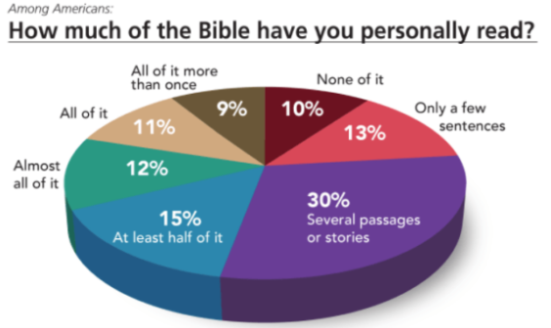

Slide 31
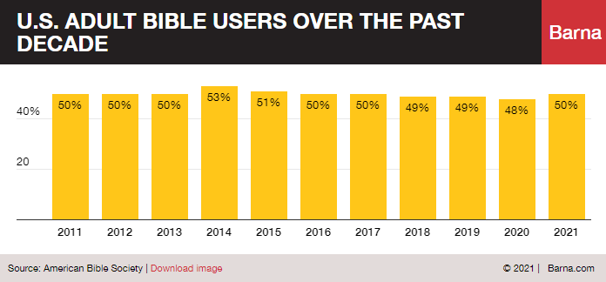
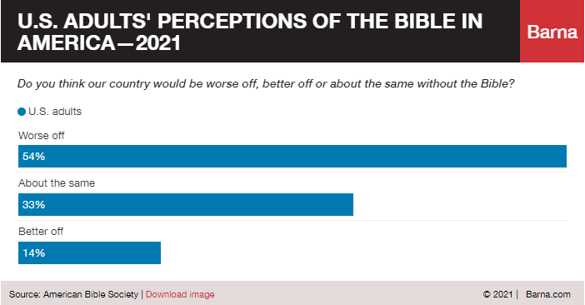

Slide 32
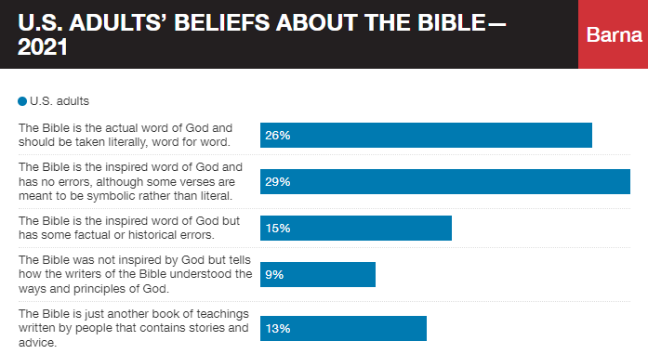
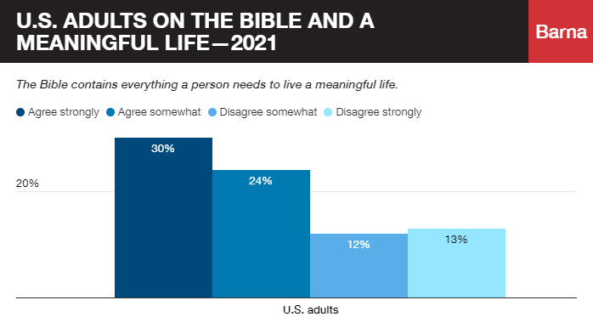

Slide 33
